Slide 1


Language
Pixel Art Editor Using SDL2
TITLE:
Develop a simple pixel art editor where users can draw and edit images pixel by pixel, with tools for drawing, erasing, and filling colors
Username: shaiful6ilam
Email: shaiful3549@gmail.com
salman4231
Email: salman542135@gmail.com
nafisislam7
Email: nafis7islam@gmail.com
hridoyqavir
Email: jamil.hridoy@northsouth.edu

Slide 2
Language
What is This Project?
| A grid-based pixel art editor using C and SDL2 |
|Allows users to draw with different colors using mouse and keyboard|
| Lightweight, simple, and responsive |

Slide 3
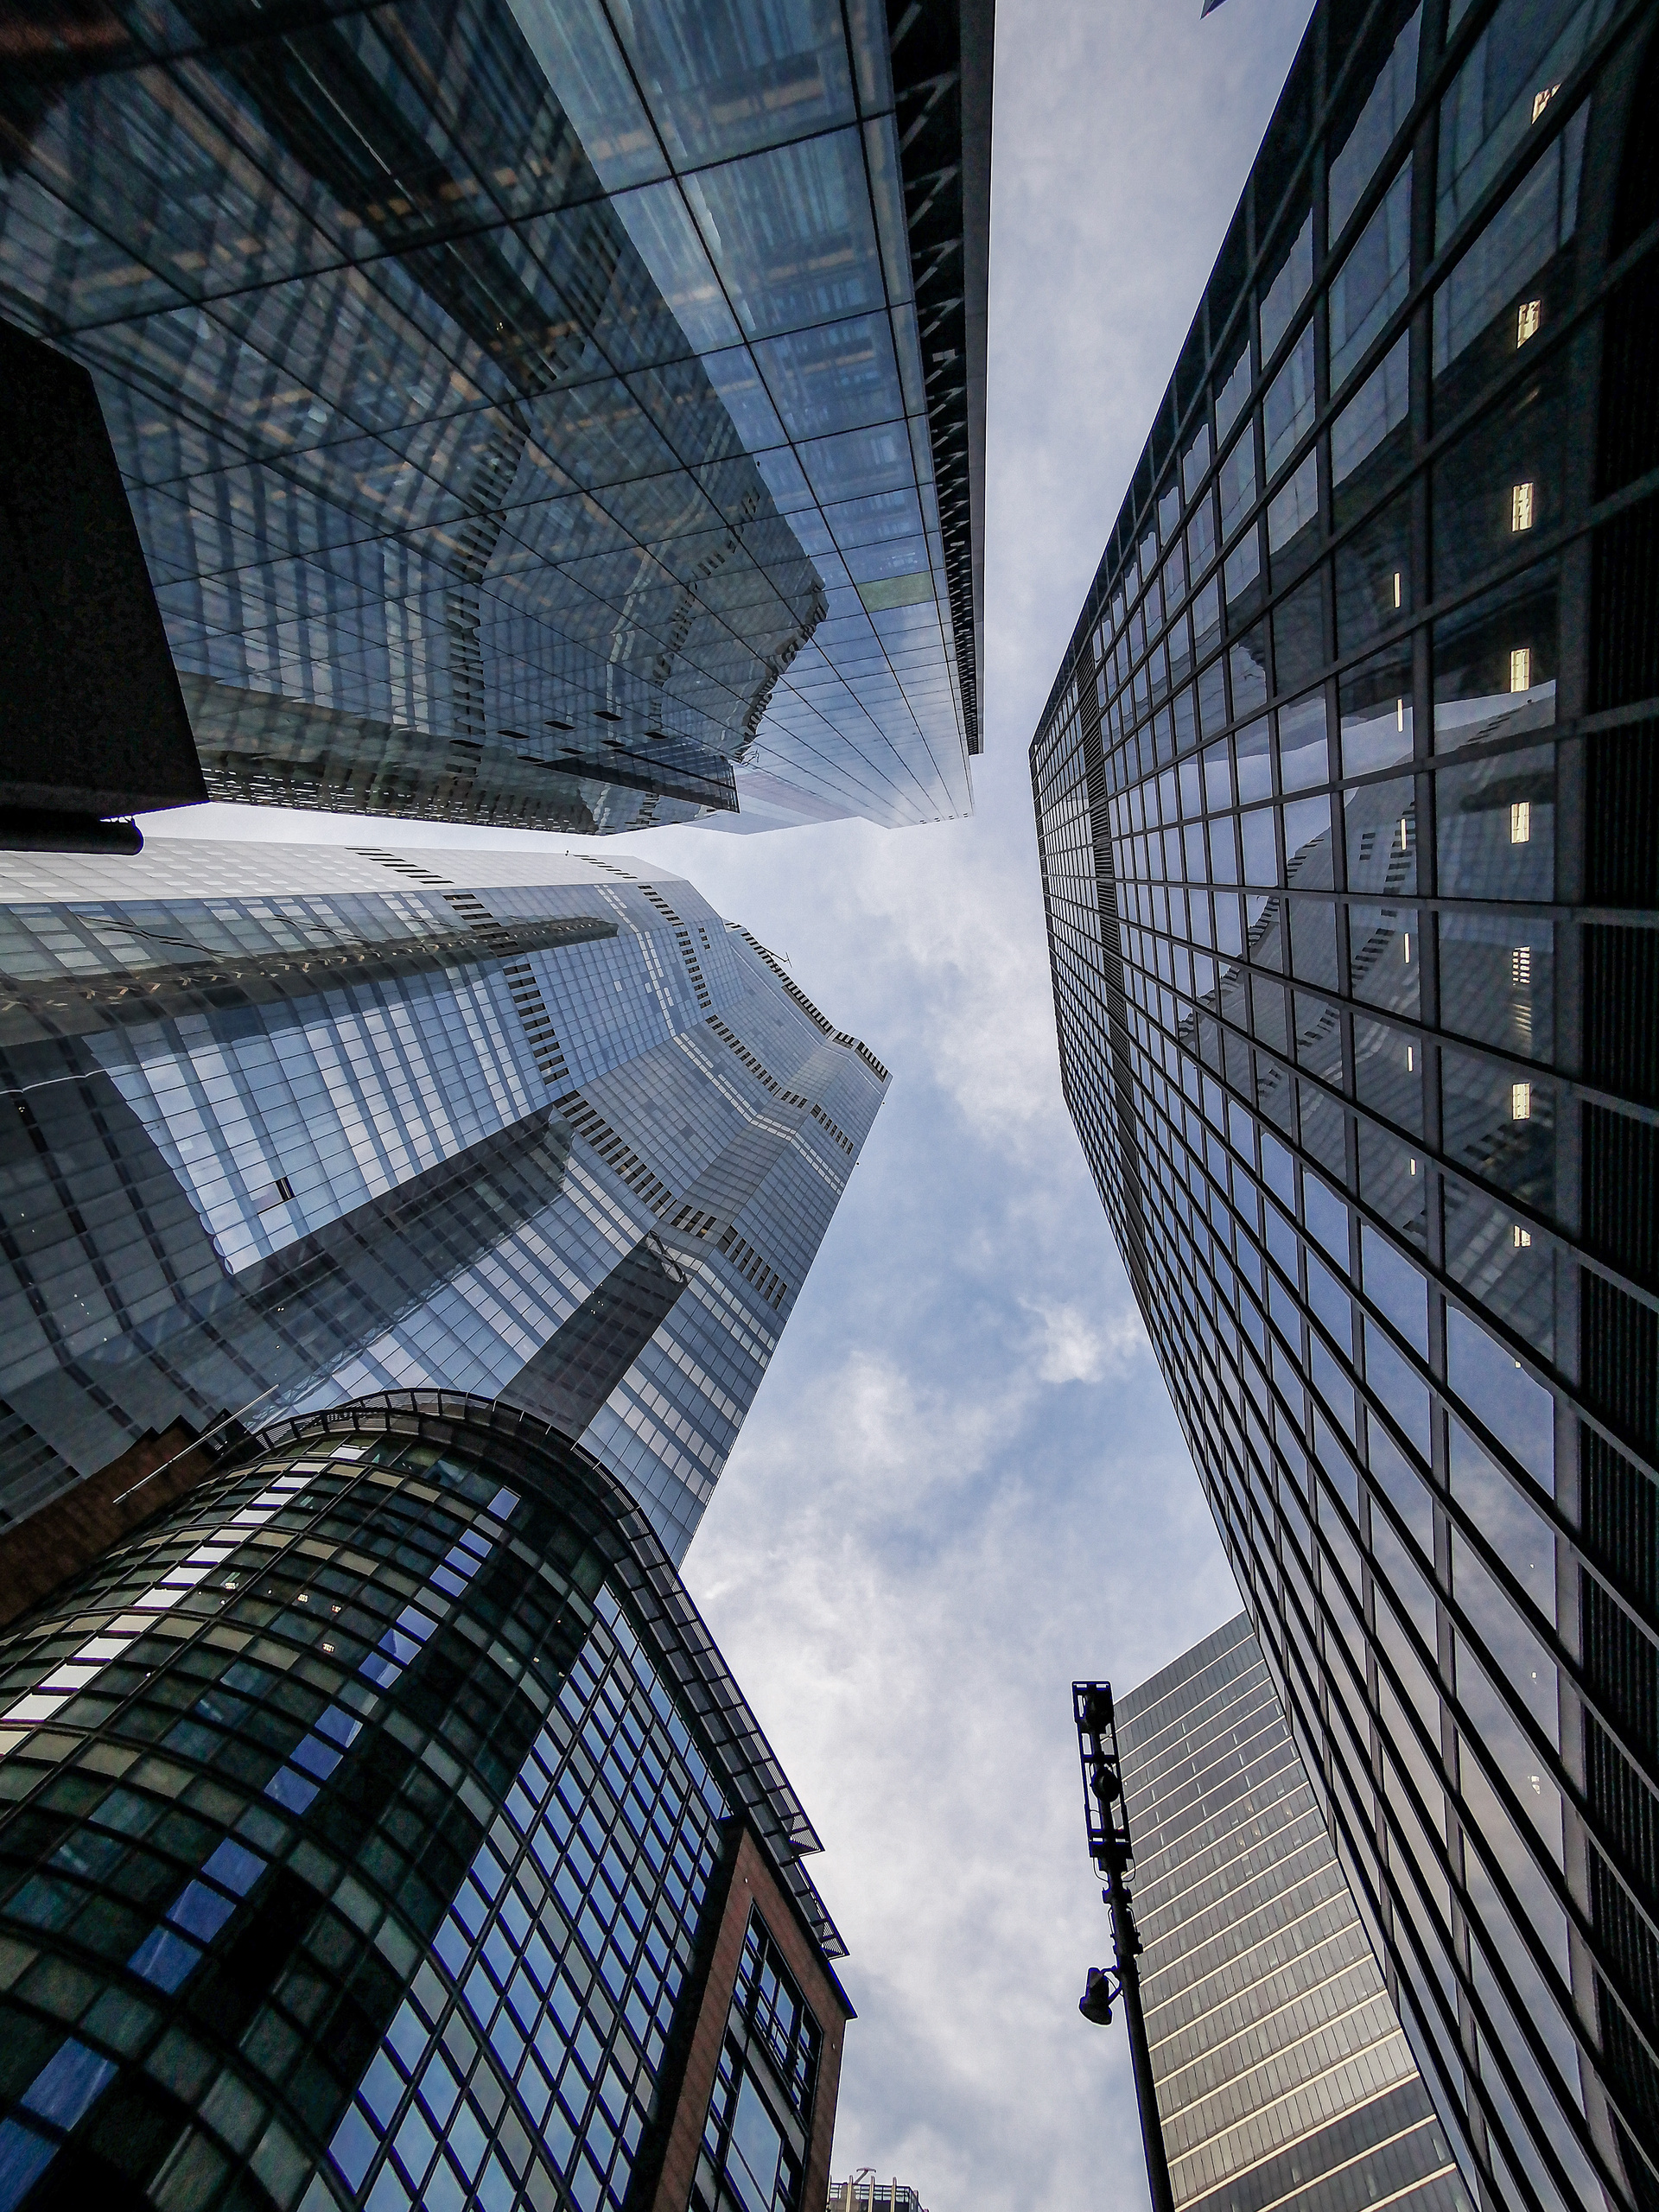
Language
Why This Project Matters?
Hands-on graphics programming with SDL2.
Event-driven programming (mouse & keyboard interactions).
Real-time rendering using an efficient grid system.

Slide 4


Language
Features Overview
32x32 pixel grid with customizable colors.
Mouse controls: Left-click to draw, right-click to erase.
R → Red
G → Green
B → Blue
W → White
K → Black
Keyboard shortcuts:
Real-time rendering with SDL2

Slide 5


Language
Code Breakdown (Big Picture).
Initialization:
SDL window, renderer,
and grid setup.
Cleanup: Properly closing SDL resources.
Event Handling: Mouse clicks & keyboard inputs for color selection.
Rendering: Updating pixels and refreshing the display efficiently.

Slide 6

Language
Code Walkthrough (Technical Details)
Grid Representation: A Color struct storing r, g, b values.
Drawing Pixels:
void drawPixel(int x, int y, Color color)
{
if (x >= 0 && x < WIDTH && y >= 0 && y < HEIGHT)
{
grid[x][y] = color;
}
}
else if (event.type == SDL_MOUSEBUTTONDOWN) {
int x = event.button.x / PIXEL_SIZE;
int y = event.button.y / PIXEL_SIZE;
if (event.button.button == SDL_BUTTON_LEFT) {
drawPixel(x, y, currentColor);
}
}

Slide 7

Language

Slide 8

Language
Challenges Faced
Event Handling Complexity:
Rendering Optimization:
SDL2 Learning Curve:
Handling multiple inputs effectively.
Ensuring smooth grid updates.
Understanding graphics rendering in C.

Slide 9
Language
Future Improvements
🚀 Color Picker UI instead of keyboard shortcuts.
🎨 Save & Load Functionality for pixel art projects.
🖌 Brush Size Options for different stroke thicknesses.
💾 Exporting Artwork as an Image File.

Slide 10

conclusion
Learned SDL2, graphics rendering, and event handling.
Simple yet effective pixel art editor in C.
Future enhancements can make it more user-friendly.

Slide 11

Language
Q&A
“Any questions?”

Slide 12
Language
thank you

